Slide 1


Titolo presentazione sottotitolo
LNSM PROJECT
Temesgen Semu Balcha
Gaetano Ivan Ferrara
Stefano Maxenti
Eliana Mazza
Milano, XX mese 20XX
Prof. Nicoli
Prof. Brambilla

Slide 2
Project Overview
Steps:
Data analysis: dealing with NaNs, outliers and noise in order to smooth the AGV’s trajectory.
Iterative NLS implementation: non-probabilistic approach to find the object’s position at each time step.
Kalman Filter implementation: probabilistic approach to track over time the AGV position.
Expected results:
The trajectory found by the NLS approach is outperformed by the implementation of the Kalman Filter.
All 4 tags present the same path, even if shifted in space according to their position.

Slide 3
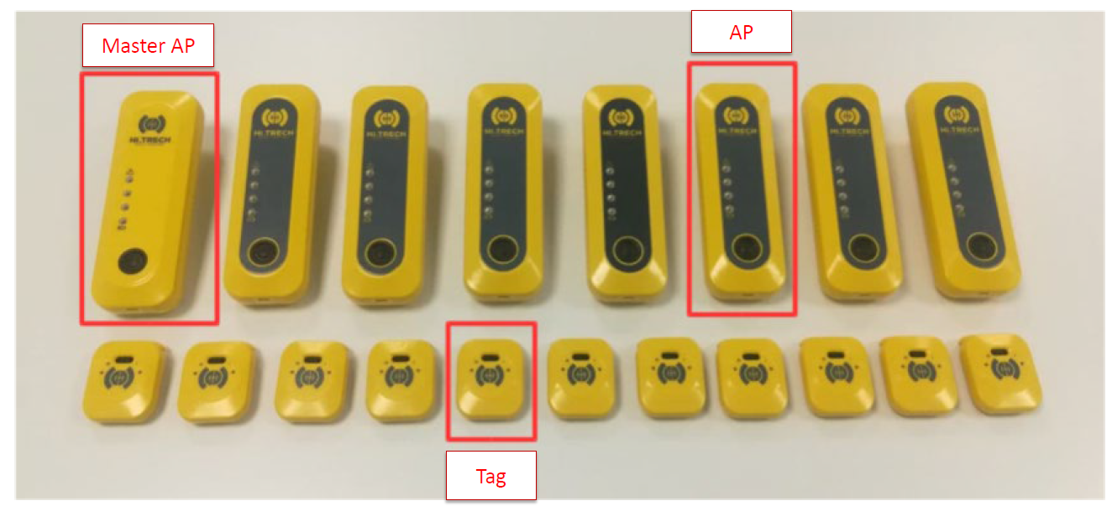
Experimental Set Up
4 tags
6 Access Points (AP2 = Master AP) at known position
5 TDOA measurements for each tag

Slide 4
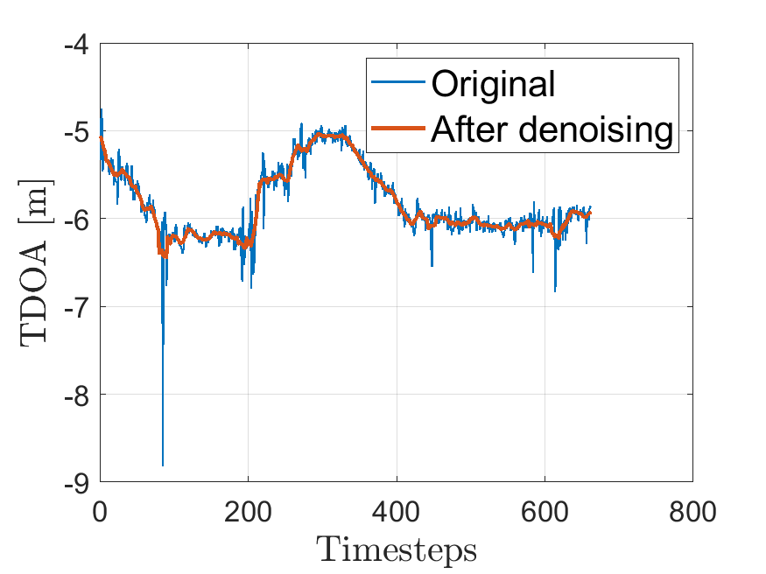
Preprocessing
Presence of NaNs
Replacement with the last valid TDOA measurement value
We try also an «offline» further denoising:
Filtering
Savitzky – Golay filtering
Note: this approach can be used when we have all the measurements.
It works a-posteriori.

Slide 5
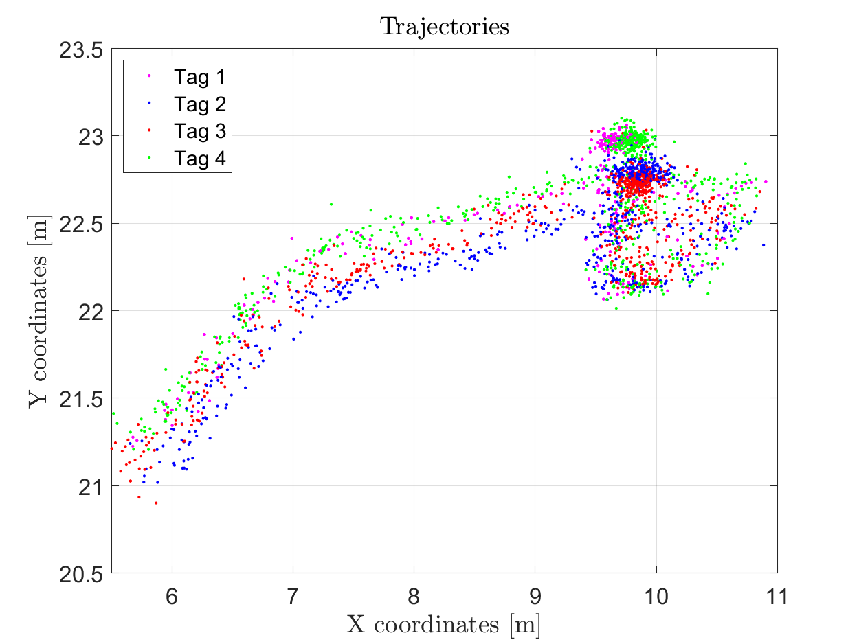
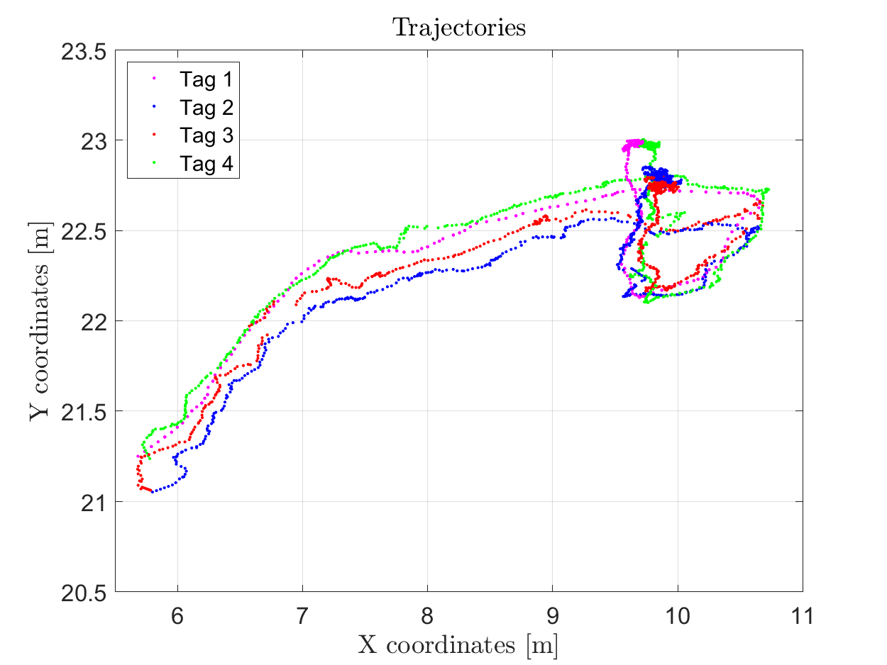
NLS Approach
We applied iterative NLS for each one of the four tags on both datasets.
For each successive iteration, the position found in the previous one is used as an initial position in the iterative NLS.
We plot the final four tags’ positions.
Results:
The final result for the «online» dataset is noisy.
The final result for the «offline» dataset is much smoother due to the further filtering.
The trajectories of the 4 tags are coherent with each other.

Slide 6
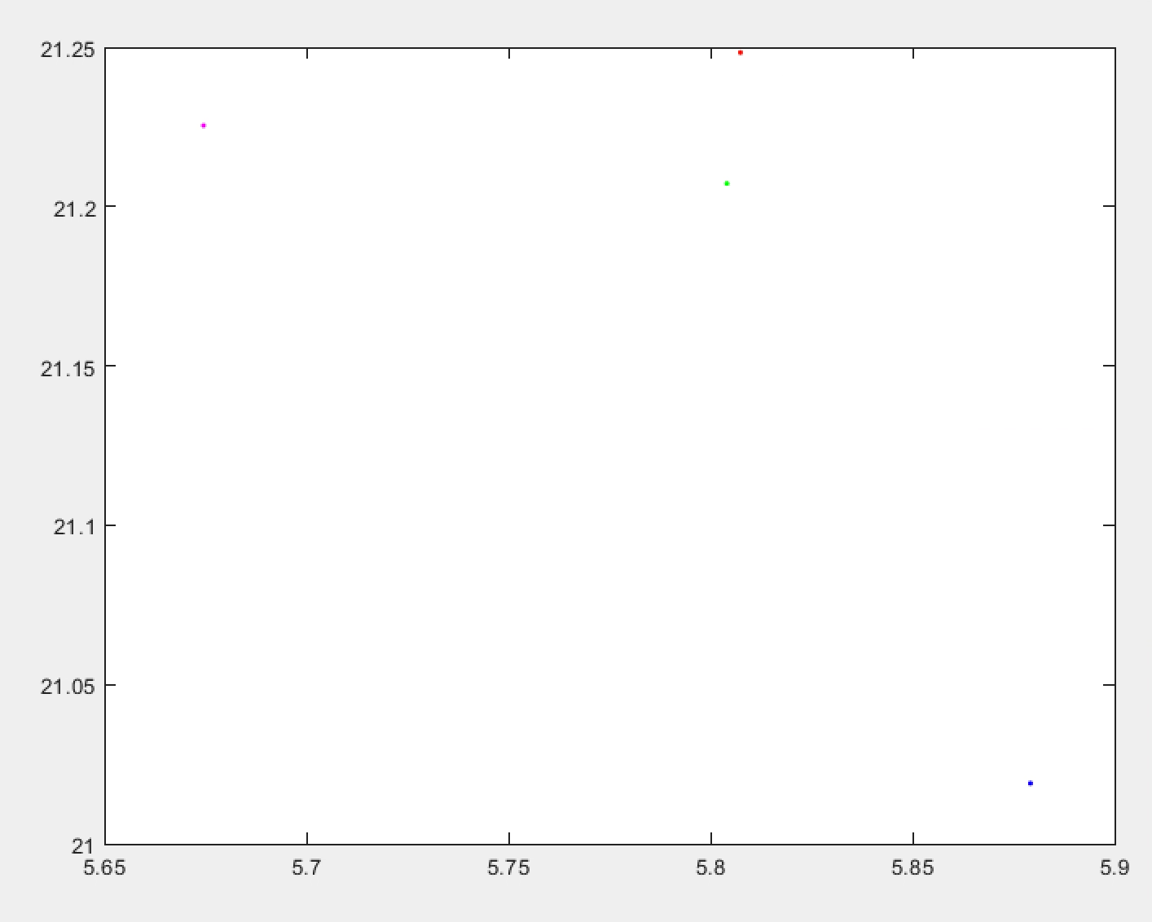

Faulty Tag
The tag characterized by fewer measurements doesn’t stop working since the trajectory is complete.
We conclude that the faulty tag has a bigger sampling time. We show the difference using the “online” preprocessed dataset.
The same behaviour is obviously visible in the EKF result as well.

Slide 7

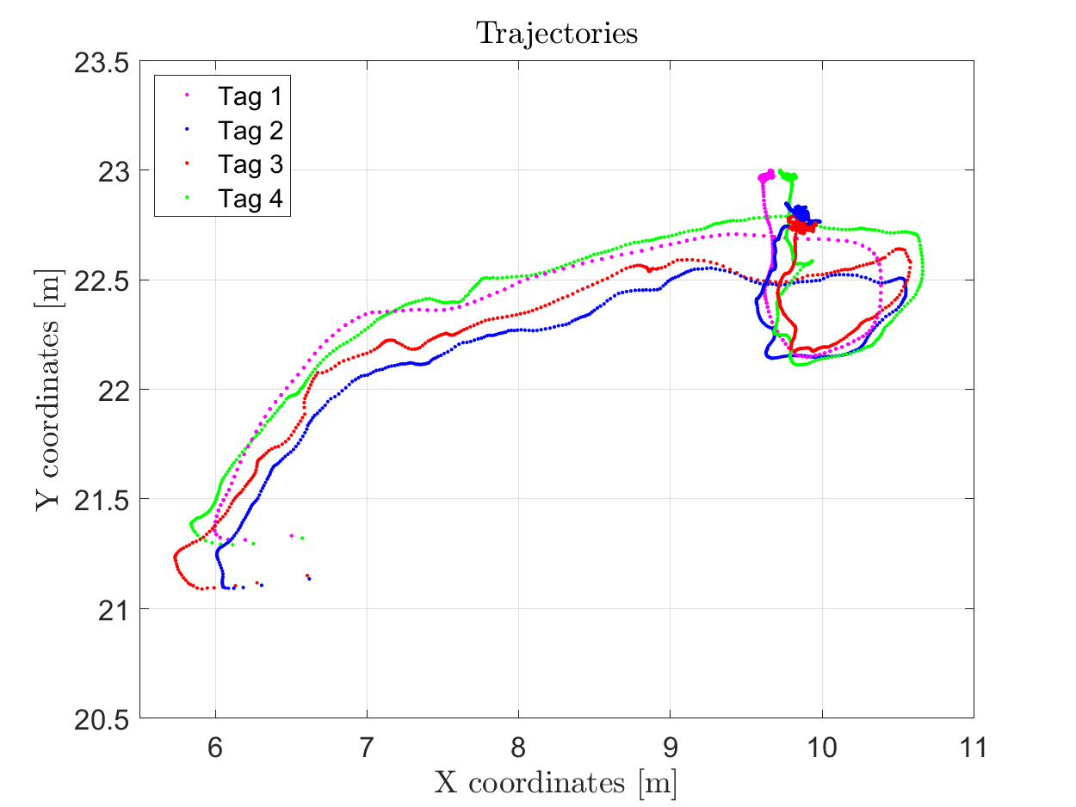
EKF Approach
To enhance the performance of the system, we applied an EKF, using the Random Walk as motion model.
We plot the final four tags’ positions, using both datasets.
Results:
The final result for the «online» dataset is less noisy than Iterative NLS.
The final result for the «offline» dataset is much smoother due to the further filtering.
The trajectories of the 4 tags are coherent with each other.

Slide 8
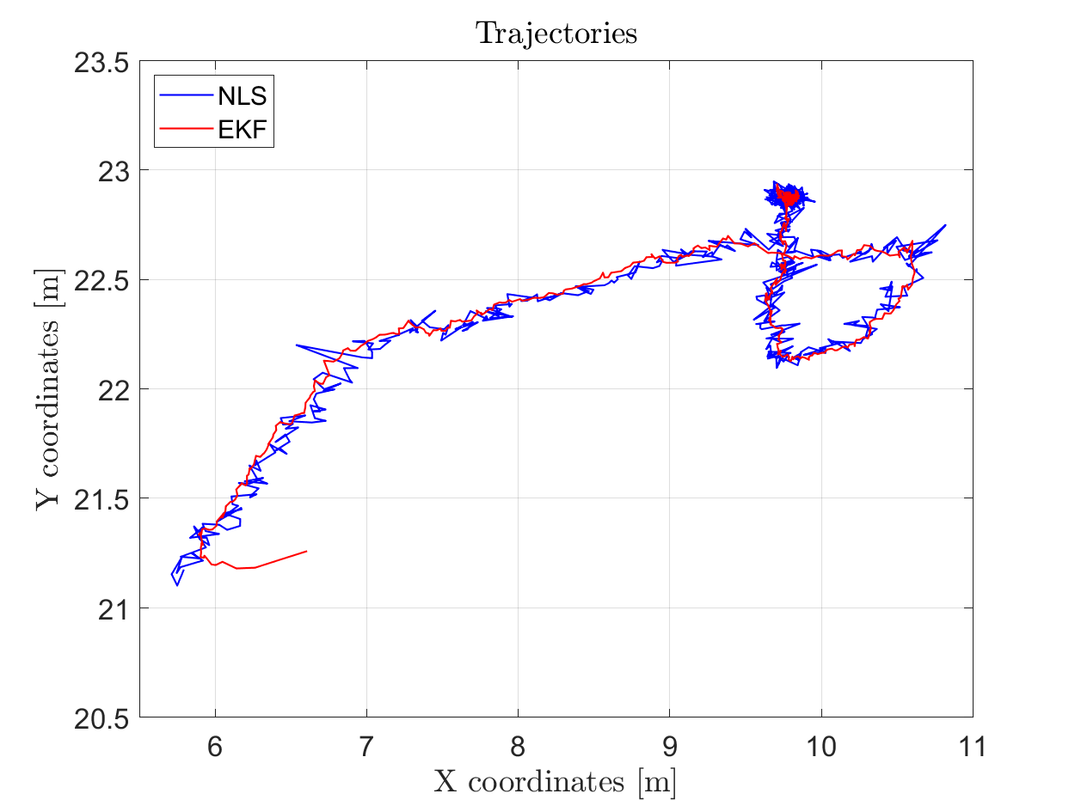
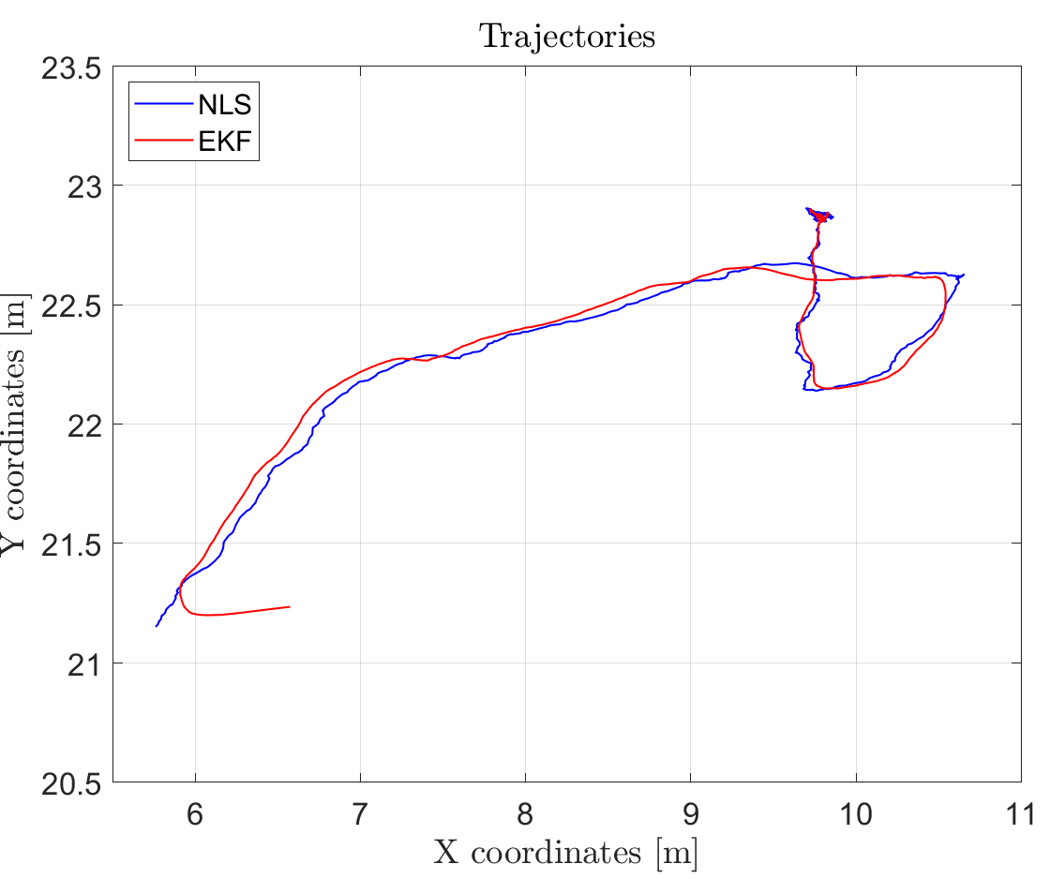
AGV Final Trajectory
After synchronizing the faulty tag, we plot the overall trajectory of the AGV by computing the mean value over x and y at each timestep, using both datasets.

Slide 9
Conclusions and Future Goals
In our experiment, the Iterative NLS is always noisier than the Kalman Filter.
In a real tracking scenario, a Kalman filter is more suitable because it takes into account previous states and therefore it is able to correct the trajectory whenever the measurements become less reliable.
The Kalman Filter requires only one iteration for each timestep, so it is also faster than the NLS which may require hundreds of iterations.
The first position of the KF is not precise, so it would make sense to use NLS to get the starting point.
Possible improvements could be obtained by using a different motion model, considering also speed and acceleration (if available).

Slide 10
THANK YOU!

